Slide 1
Lunar Cycles & Human Behavior
Data Science Capstone Project
by Matthew E. Parker

Slide 2

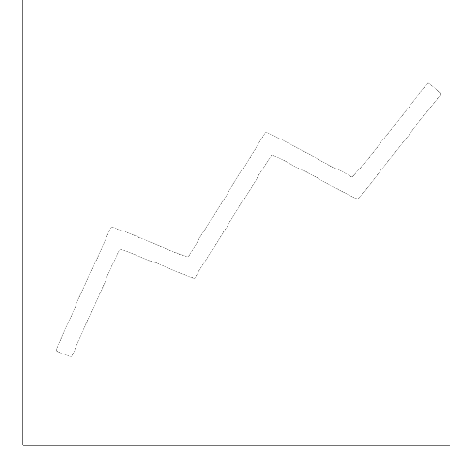

Project Overview
Abstract
Inspired by academic studies that have shown a regular increase in reported crimes during full moons, this project aims to investigate whether other human behavior is correlated to lunar phases.
Approach
Gather a year of tweets from Twitter for various keyword searches (>365,000 tweets)
Gather a year of financial data on a variety of stocks and currencies
Use Facebook Prophet modeling to examine correlation to lunar cycles
$ € ₿

Slide 3
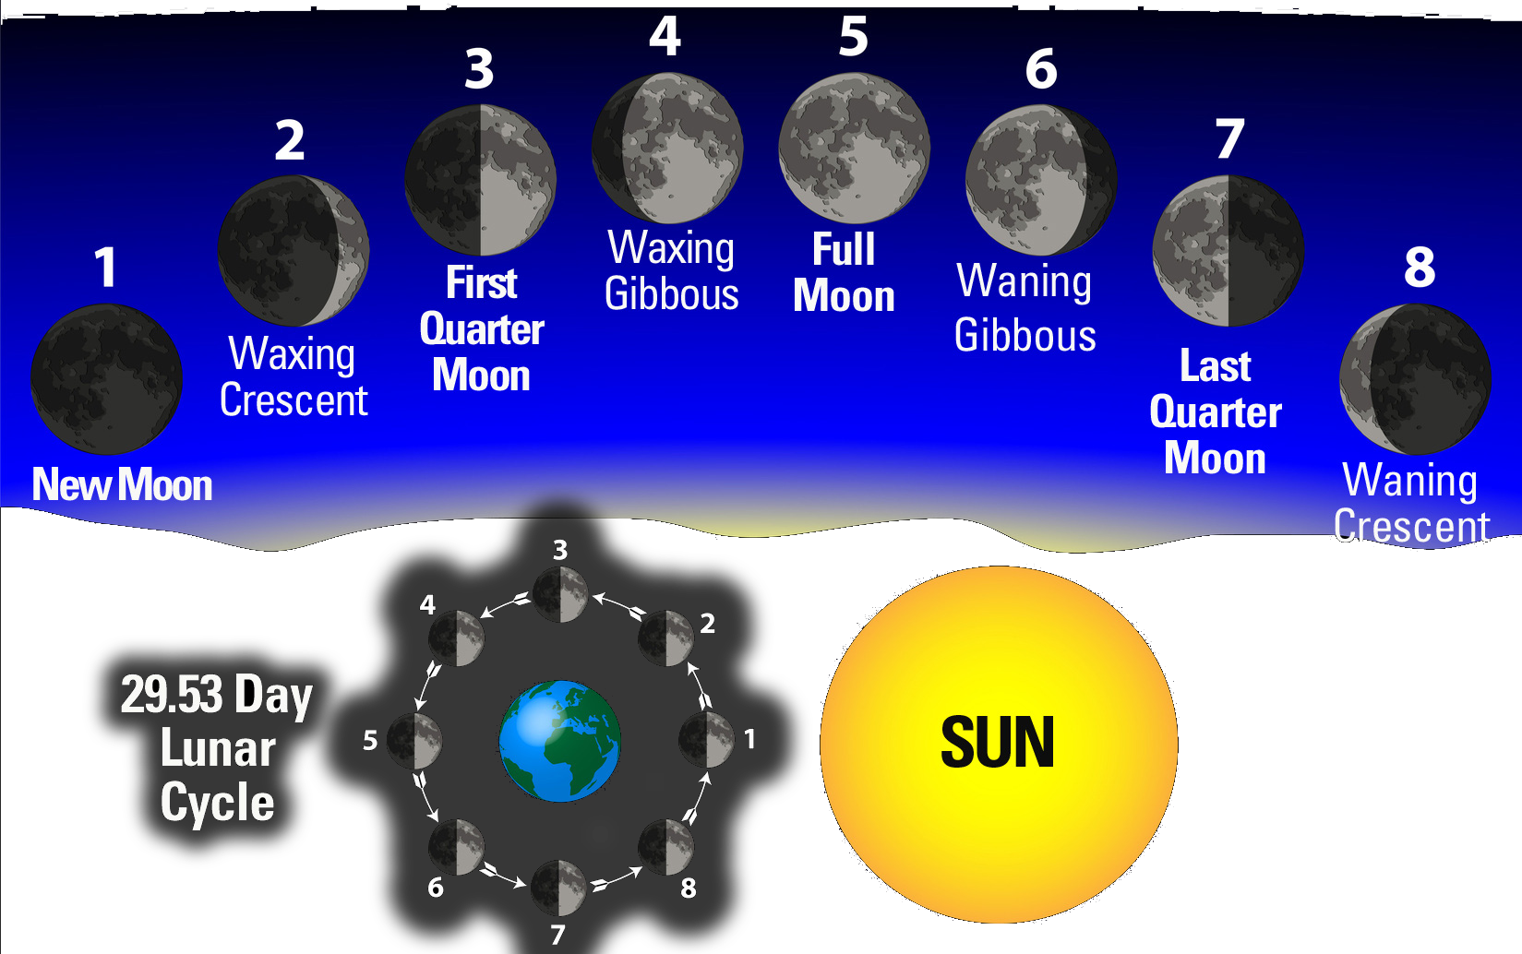
Lunar Phases
Important Notes on Lunar Phases
Lunar cycle lasts 29.53 days
Each major phase (bold) can appear to last 2-3 nights
Lunar phases only refer to how much light is reflected from the Moon
no relation to tidal/gravitational effects or to Moon’s proximity to Earth
First Full Moon of 2018 was January 2

Slide 4
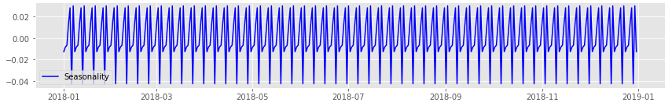
Methodology, 1
Twitter Sentiment Analysis
Scraped 1,000 tweets per day for 365 days of 2018
Repeated process for 7 different keyword searches
Used Natural Language Processing (NLP) to determine general sentiment of each tweet (positive / neutral / negative)
Modeled tweet sentiment with seasonal decomposition to detect whether any cycles existed
Revealed cyclical behavior on scale of 7.4 days and 29.5 days (major lunar phases & lunar month)

Slide 5
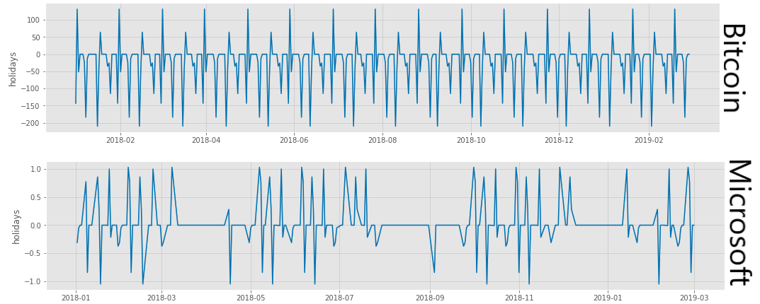
Methodology, 2
Analysis with Facebook Prophet
Incorporated FBProphet’s ‘holidays’ feature to separate lunar cycle effects from other seasonalities (work week, monthly, etc.)
Modeled financial data from various sources, as well as the various tweet data
All showed distinct seasonality correlating with lunar phases
Oddly, different stocks/currencies showed different seasonalities

Slide 6
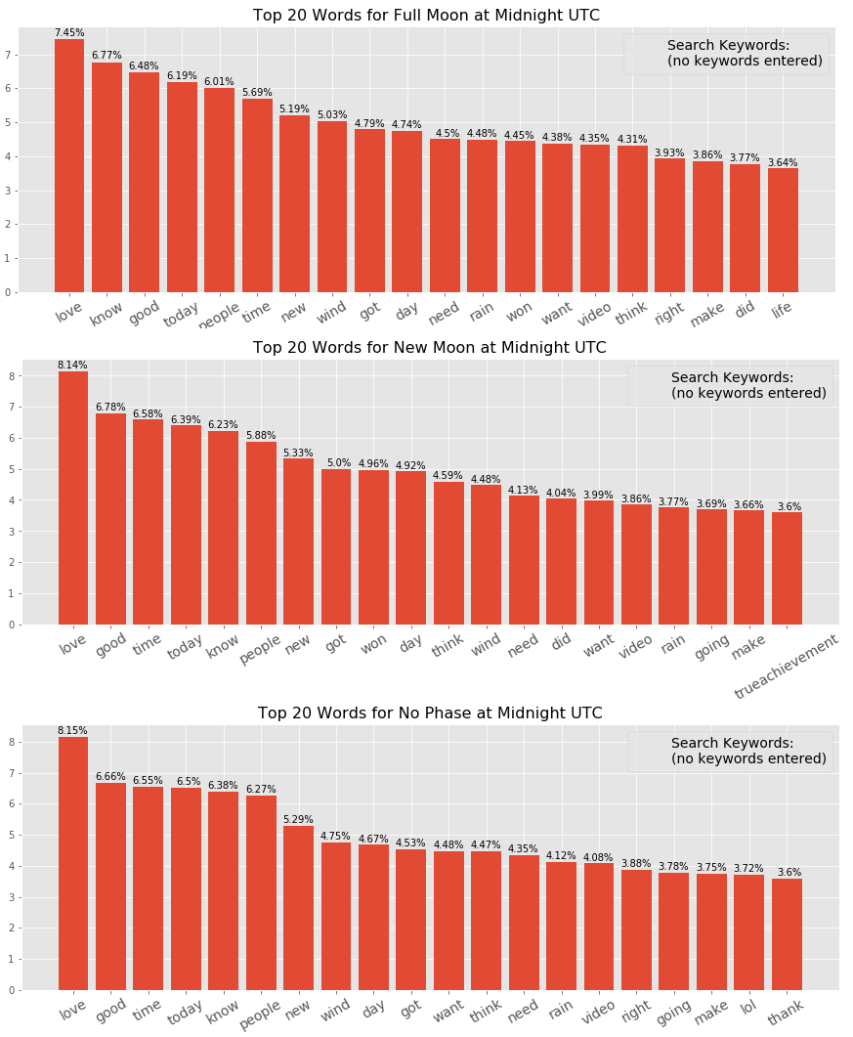
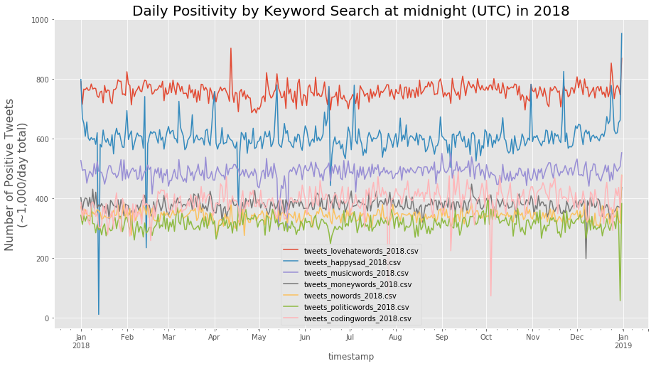
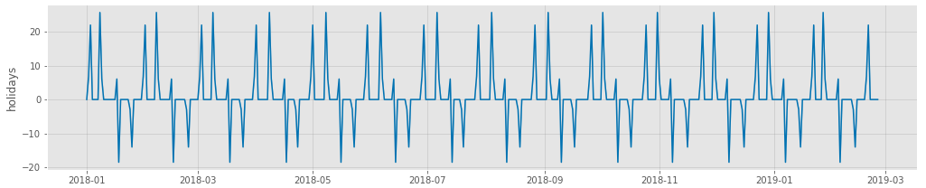
Exploring Twitter Sentiment

Slide 7
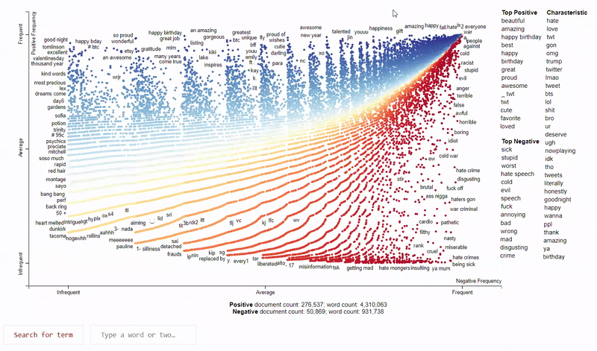
Visualizing with Scattertext

Slide 8
Take-aways & Recommendations
Lessons
Human behavior appears to have a small correlation to lunar cycles
Full Moon & Last Quarter Moon exhibit increased positivity
New Moon & First Quarter Moon exhibit increased negativity
Financial markets are not immune to lunar correlation, though +/- depends on stock/currency
financial markets also exhibit tendency to immediately correct the day after a lunar phase
Recommendations & Future Research
Run models on multiple years of data, and larger volume of tweets throughout the day
Investors ought to take lunar cycles into consideration when building their forecasts & algorithms
The Scattertext library stands to be very useful in many fields of research and government

Slide 9
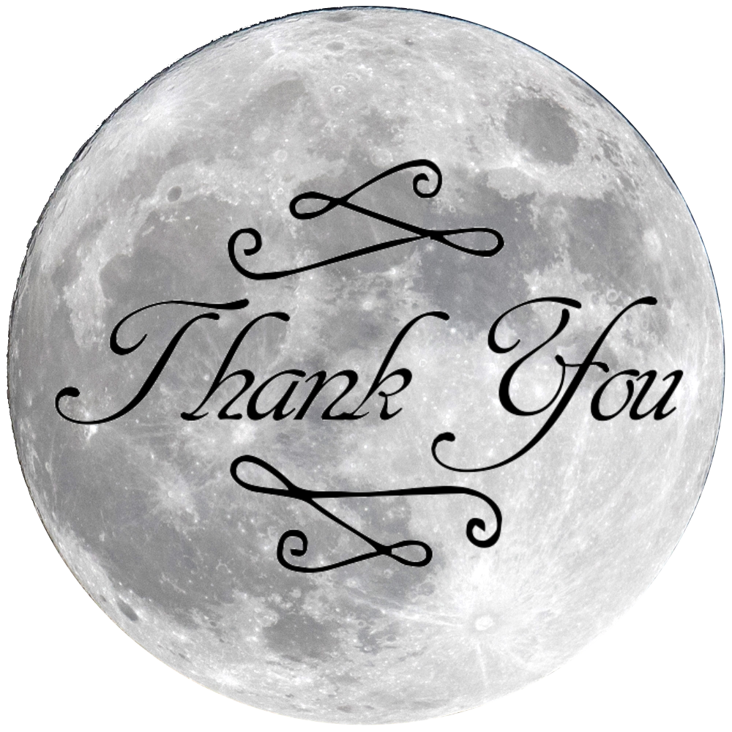
Thank you
Contact me at:
mattheweparker@gmail.com
Github:
https://github.com/magnawhale/capstone_project

